Slide 2
PRESICION MEDICINE
&
ANTI-AGING
ALEXANDER V MELERZANOV MD PHD
DEAN OF BIOLOGICAL AND MEDICAL PHYSICS DEPARTMENT
MOSCOW INSTITUTE OF PHYSICS AND TECHNOLOGY WWW.MIPT.RU
M83071@GMAIL.COM

Slide 3
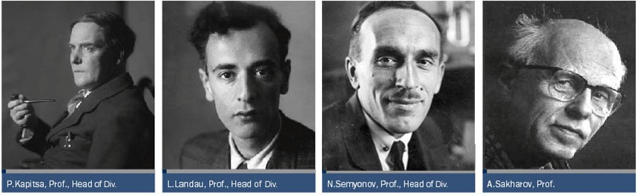
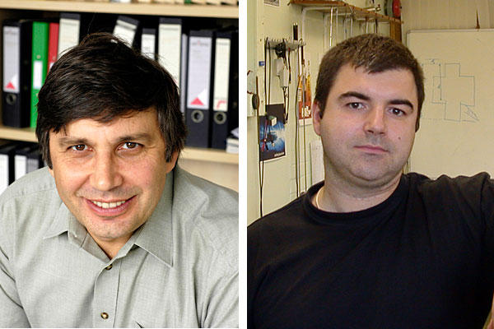
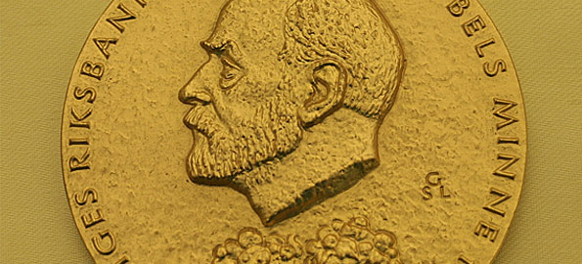
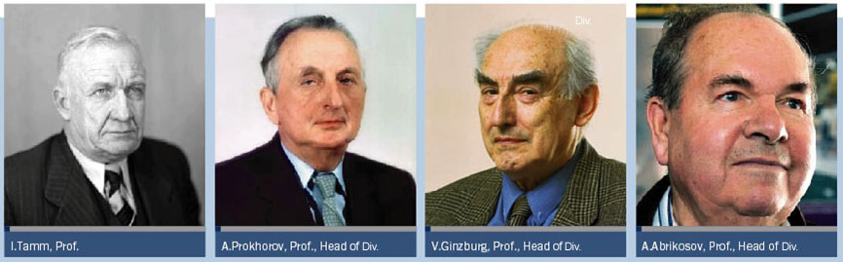
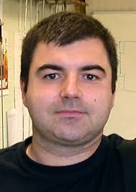
MIPT HISTORY
For the time of MIPT’s existence 8 Nobel prize winners were its professors and founders
2 Nobel prize laureates for graphene in 2010 are MIPT graduates
Notes:
raduates?

Slide 4
NEW DEFINITIONS FOR MEDICINE
TRANSLATIONAL MEDICINE is a discipline within biomedical and public health research that aims to improve the health of individuals and the community by "translating" findings into diagnostic tools, medicines, procedures, policies and education.
PREVENTIVE MEDICINE consists of measures taken for disease prevention, as opposed to disease treatment. Just as health encompasses a variety of physical and mental states, so do disease and disability, which are affected by environmental factors, genetic predisposition, disease agents, and lifestyle choices.
PERSONALIZED MEDICINE is a medical model that proposes the customization of healthcare - with medical decisions, practices, and/or products being tailored to the individual patient. In this model, diagnostic testing is often employed for selecting appropriate and optimal therapies based on the context of a patient’s genetic content or other molecular or cellular analysis.

Slide 5
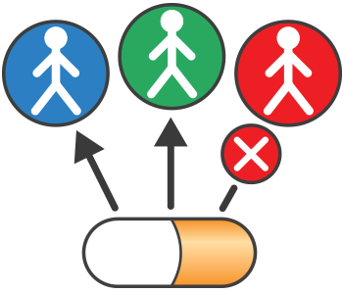
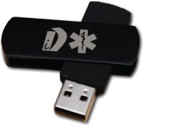
NEW HEALTHCARE MODEL
Precision medicine is a medical model for high-efficiency, low-cost prevention and treatment of diseases tailored to individual patients based on their genetic content. (CAS, Chen Na)
PRECISION MEDICINE
SCIENTIFIC RESEARCH
PERSONALIZED HEALTH PRODUCT
PERSONAL DATA
www.amazon.com
www.fda.gov

Slide 6
PRECISION MEDICINE
Far too many diseases do not have a proven means of prevention or effective treatments. We must gain better insights into the biological, environmental, and behavioral influences on these diseases to make a difference for the millions …who suffer from them. Precision medicine is an emerging approach for disease treatment and prevention that takes into account individual variability in genes, environment, and lifestyle for each person. While some advances in precision medicine have been made, the practice is not currently in use for most diseases.
BARAK OBAMA, THE EX-PRESIDENT OF USA
(a quote from NIH source)

Slide 7
AGING AS A DISEASE I
Classifying ageing as a disease has an extreme importance for the whole approach to the health maintenance and is the only way out from the future economic collapse of the fast aging world.
Accepting the hypothesis that ageing is a disease brings us to the following statement – aging can be treated as all other complicated lifelong chronic diseases. In this case treatment of ageing should qualify for insurance coverage and therefore give another reason for pharmaceutical and food companies to support anti-aging science and practice. Formal acceptance of anti-aging medicine and anti-aging physicians with a respective education and qualification is an obvious next step.

Slide 8
AGING AS A DISEASE II
Acceptance of ageing as a disease will make us to come back to the concept of valueology (valeology - science of health maintenance) based on new achievements of translational medicine. Genetics and OMICs technologies screening together with bioinformatics will fine tune the approach to healthy life style as an initiative part of anti-aging medicine (or preventive medicine) making it more personalized and therefore more effective for prolonging productive life. Bringing in the term of preventive medicine as a first stage of anti-aging medicine we come to the major question: when do we start to diagnose ageing process as a disease? When maturing switches to aging? With first signs of decline of any physiological function? Or in the period between 40 and 50 years when majority of aging biomarkers changes dramatically?

Slide 9
Aging - the cause of many diseases (more than 200 diseases exponentially increase mortality with age)
Mortality in the USA (2001-2010)
Courtesy of prof. A.Moskalev
WHO
Age, years

Slide 10

Aging indicators
Loss of skin elasticity
Graying
Lentigo
Memory impairment
Increased fatigue
Depression
Metabolic syndrome
Sarcopenia
The loss of reproductive function
Immunosenescence
The weakening of the reparative capacity
The systemic inflammation,
Fibrosis,
Lipomas,
Sclerosis,
Amyloidosis

Slide 11
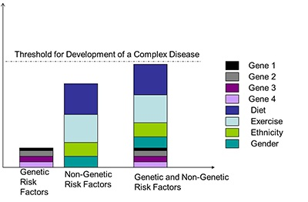
Genetic predisposition vs Modifiers
(Coriell personalized Medicine Collaborative)

Slide 12
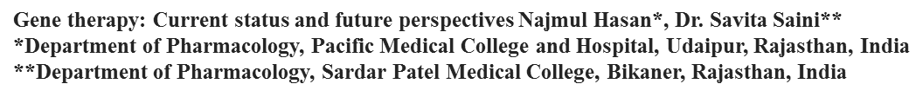
GENE THERAPY
James Watson was quoted as saying “we used to think that our fate was in our stars, but now we know, our fate is in our genes.”
Concept of gene therapy
Originally, the term gene therapy referred to proposed treatments of genetic disorders by replacing a defective gene with its normal counterpart. Currently, it includes all treatments in which there is an introduction of genetic material into body cells to treat a variety of diseases.
Somatic gene therapy- It involves the insertion of a functional and expressible gene into a target somatic cell to correct a genetic disease.
Germline gene therapy- In this approach, functional genes are introduced into germ cells (sperm or egg). Therefore the changes due to therapy would be heritable.

Slide 13
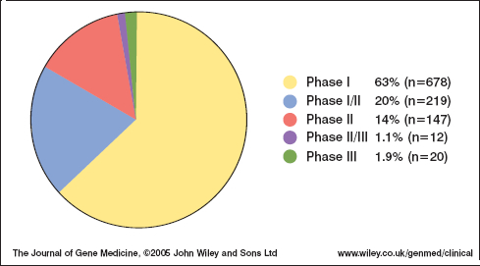
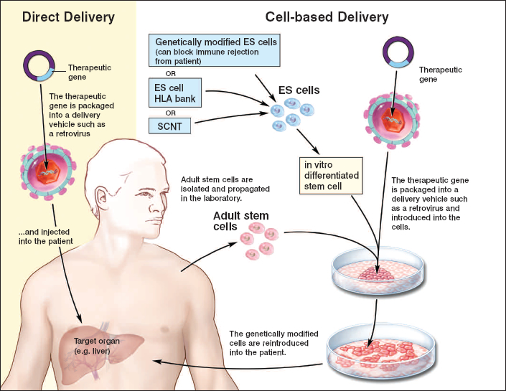
GENE THERAPY
Clinical trials
&
basic approaches

Slide 14
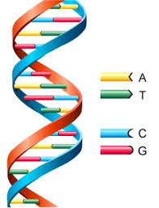
GENE THERAPY
HUMAN GENE THERAPY TRIALS
Severe combined immunodeficiency (SCID)
Cystic fibrosis
Familial hypercholesterolemia
Emphysema
Thalassemia
Sickle-cell anemia
Gaucher’s disease
Fanconi anemia
Melanoma
Glioblastoma
Duchenne muscular dystrophy
Diabetes mellitus

Slide 15
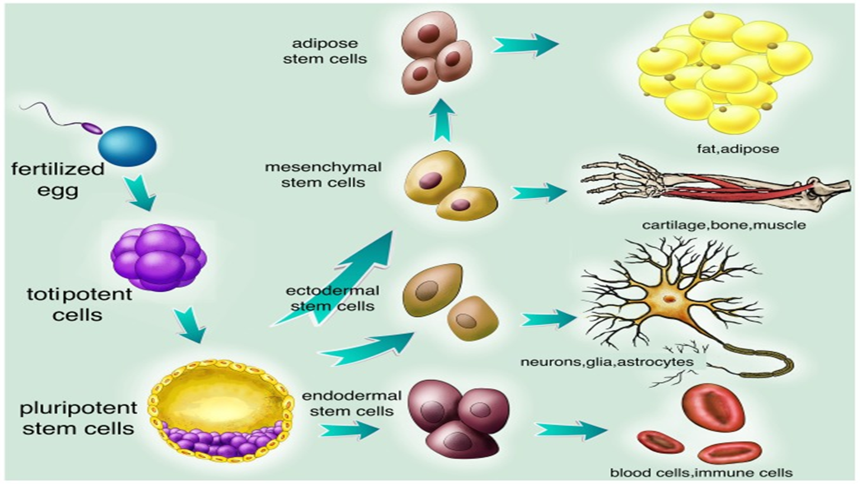
STEM CELLS TECHNOLOGIES
Molecular medicine reports feb 2016

Slide 16

SVF IS A DRUG
New draft FDA guidance explicitly single out SVF for attention and define it as a biological drug. (Paul Knoepfler)
Internet findings:
1/ JOINTS TREATMENT
2/ SKIN RECOVERY
3/ AUTOIMMUNE DISEASES
TREATMENT
4/ CARDIOTHERAPY
5/ HEPATOTHERAPY
6/ ED

Slide 17

ASC
НАЛИЧИЕ
CD9 CD10
CD13 CD29
CD44 CD49(d)
CD49(e) CD54
CD55 CD59
CD73 CD90
CD105 CD106
CD146 CD166
HLA I Fibronectin
Endomucin
ASMA (α-actinin, specific for smooth muscles)
Vimentin
Collagen-1

Slide 18
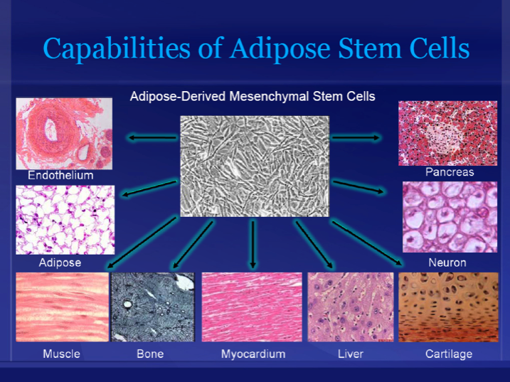
СК из ЖТ (продолжение)
ОТСУТСТВИЕ
CD116 CD14
CD19 CD31
CD34 CD45
CD79L CD80
CD117 CD133
CD144
HLA-DR
c-kit
MyD88
STRO-1
Lin
HLA II

Slide 19
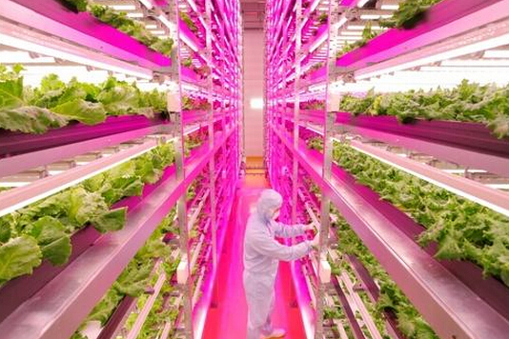
POTENCIAL USE OF ASC
1.FREEZE AND KEEP
2. THERAPY FOR LOCAL ATROTHIC AND INVOLUTIONARY CHANGES
3.CARTILAGE DEGENERATION THERAPY
4.AUTOIMMUNE DISEASES THERAPY
TREATMENT FOR VIRTUALLY
ALL INFLAMATIONS
PROMT TO FIBROSIS
6.ACTIVE COMPONENT
OF FAT TRANSFER
7.AESTHETICS
8.BIOSUBSTACNES
“FACTORY”

Slide 20
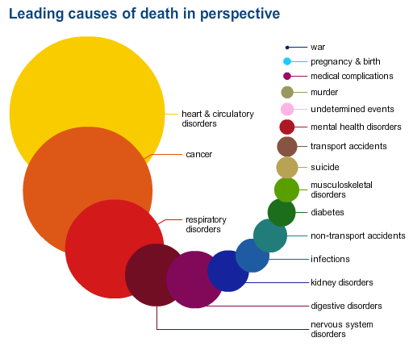
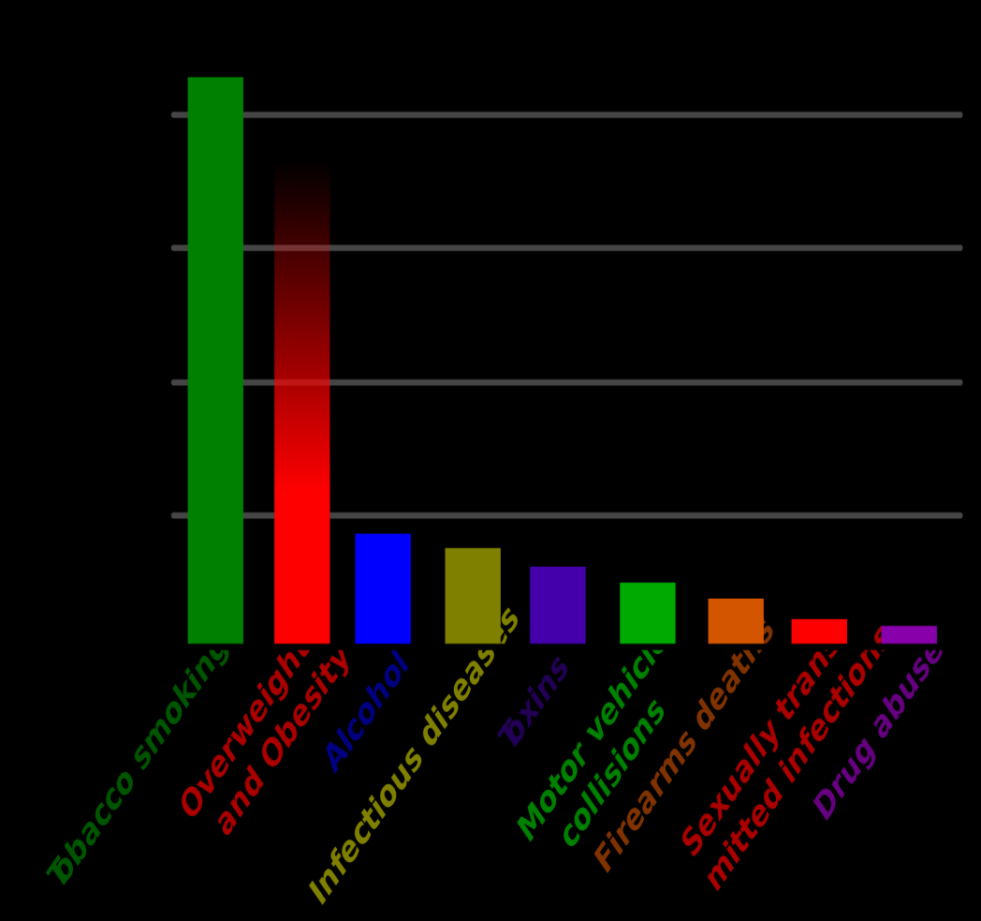
Mortality and Prevention
Leading causes od death (www.vox.com)
Preventable causes of death (wiki)

Slide 21
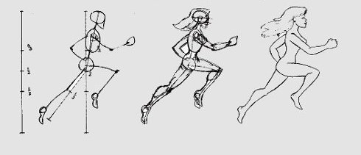



SOLUTION

Slide 22
Precision medicine principles to fight aging I
Family history
Features of a Family History that Increase Risk
Having one or more close relatives with a medical condition.
Having a relative diagnosed with a condition at an early age (typically before age 55).
Having a relative with a disease that is more rare in a certain gender (for example, a female with heart disease).
Having a combination of diseases that run in your family (for example, both diabetes and heart disease). (University of Utah Heath Science)
Genetic testing of parents – estimates but does not calculate (NIH)
2. Prenatal diagnostics (fetus DNA in mother’s blood and a variety of other tests)
3. Genetic studies
Monogenic diseases including Obesity
Polygenic diseases (Cleft lip, Congenital hip dislocation, Pyloric stenosis etc)
Genetic susceptibility including Fat mass & obesity associated (FTO) gene (genetic predisposition to cancer, diabetes, asthma, CVD)

Slide 23
.
Precision medicine principles to fight aging II
4. Modifiers (Food, Lifestyle, Environment)
Heart disease. Regular exercise can help improve your heart health.
Recent studies have shown that interval training is often tolerated well in
people with heart disease, and it can produce significant benefits.
Diabetes. Regular exercise can help insulin more effectively lower blood sugar level.
Physical activity also can help you control your weight and boost your energy.
Asthma. Often, exercise can help control the frequency and severity of asthma attacks.
Back pain. Regular low-impact aerobic activities can increase strength and endurance
in back and improve muscle function. Abdominal and back muscle exercises
(core-strengthening exercises) may help reduce symptoms by strengthening
the muscles around spine.
Arthritis. Exercise can reduce pain, help maintain muscle strength in affected joints
and reduce joint stiffness. (Mayo clinic recommendations)
Less healthy diets cause nearly one in ten (9%) cancer cases
42% cases considered – preventable, including 19% cause by smoking as a SINGLE cause and 9% diet caused. (Cancer research UK)

Slide 24
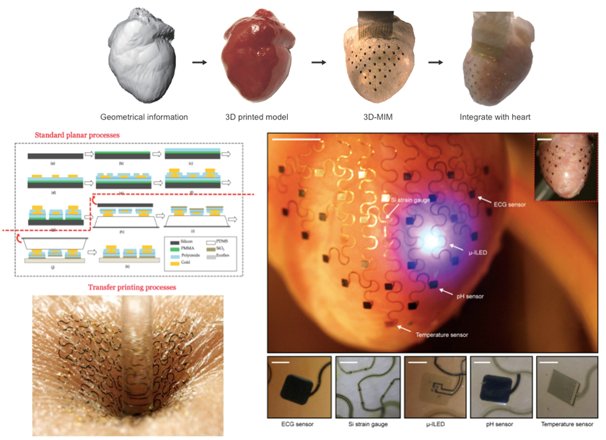
OUTCOME 2013/PROSPECTS 2016
Worldwide, from 1990 to 2013, life expectancy at birth rose by 6.2 years, healthy life expectancy at birth rose by 5.4 years.
Centenarians (age 100+ years) markedly delay disability towards the end of their very long lives, at an average age of ~93 years (that’s 20-30 years beyond the non-centenarians).
We still have great potential to prolong healthy lifespan (A.Moskalev)
From lecture of I.Efimov MIPT 2015

Slide 25
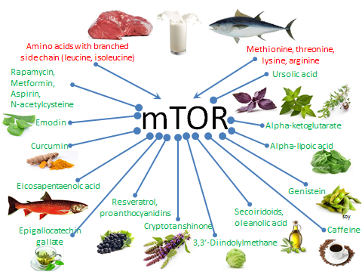
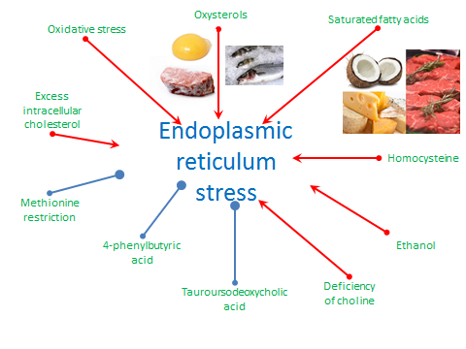
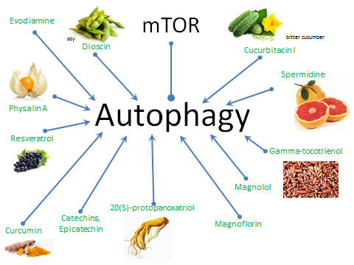
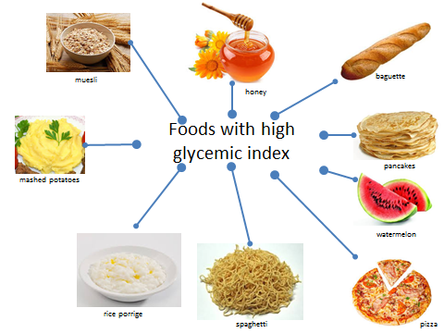
FOOD FACTORS (by A.Moskalev)

Slide 26
Precision medicine treatment
Although cancer and aging have been studied as independent diseases, mounting evidence suggest that cancer is an aging-associated disease and that cancer and aging share many molecular pathways.
Telomerase at the intersection of cancer and aging Bruno Bernardes de Jesus and Maria A. Blasco
Instead of standard care options after cancer was detected:
Testing a cancer to find out if a certain type of treatment will work on it
Biopsy or blood test for circulating cancer stem cells – personalized care based on cancer sensitivity
Genetic testing to choose the existing medicine from bioinformatics library VS
Search for new molecules for new discovered mutations

Slide 27

The Cancer Genome Atlas by NIH
Poor prognosis and overall public health impact
Cervical cancer
Cholangiocarcinoma
Esophageal carcinoma
Liver hepatocellular carcinoma
Mesothelioma
Pancreatic ductal adenocarcinoma
Paraganglioma & Pheochromocytoma
Sarcoma
Testicular germ cell cancer
Thymoma
Uterine carcinosarcoma
Uveal melanoma
333 types of Prostate cancer are under investigation!

Slide 28
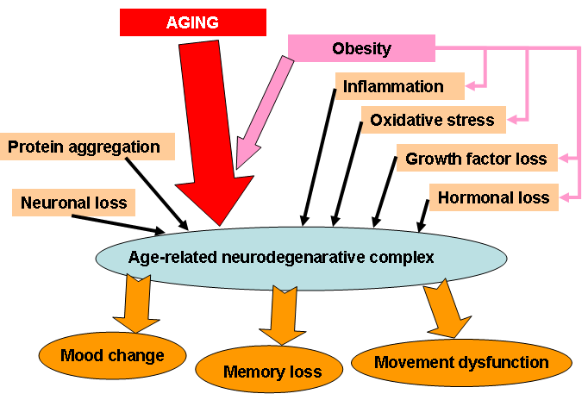
NEURODEGENERATION

Slide 29
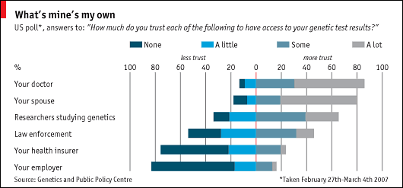
Implementation of Precision Medicine into practice
Classical questionary & genetic testing
Deep patient’s involvement & individual approach
Change of law & regulations including insurance coverage

Slide 30
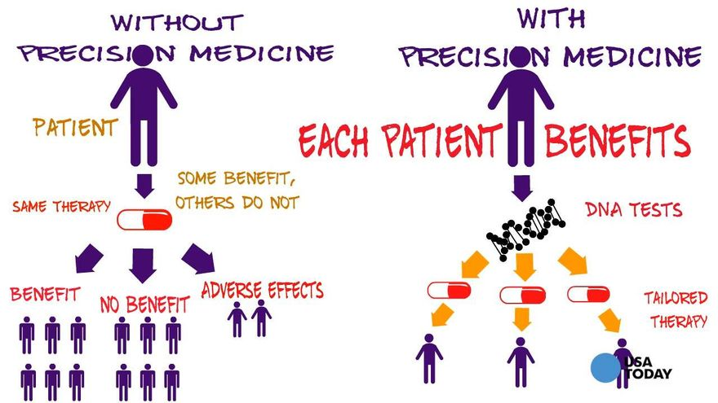
To make Precision Medicine happen:
New approach to physician training (Biomedicine)
New role of scientists in practical healthcare (translational medicine)
Public education through mass-media
Law initiatives to change the insurance policy (personalized medicine)

Slide 31
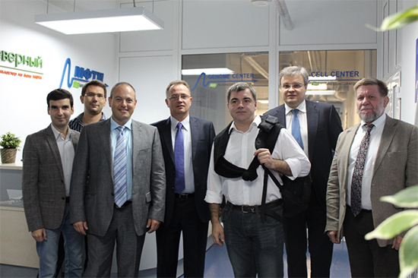
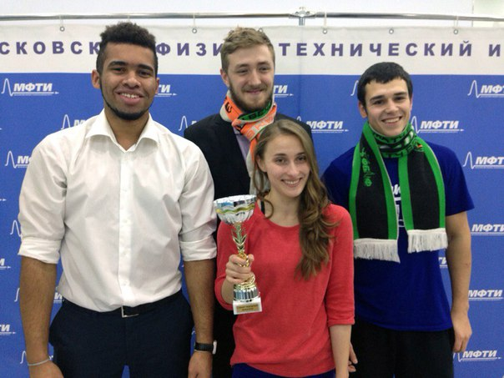
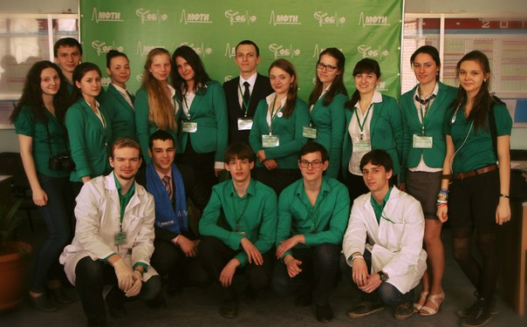

THANK YOU FOR YOUR ATTENTION

